Slide 1
Analysis of Global Crime Data
Group 11
Beatriz Leite
Dongdong Song
Kejin Liu
Sai Sravanthi Sunku
Jeremy Perez

Slide 2
Introduction
Crime is a subject of global interest. No matter where you live or how old you are, we all worry about our safety.
With crime being all over the news everyday, we get the sense that crime rates keep going up. Is it true that the global crime rate is increasing?
The GDELT Project tracks global media and news to update the global crime data every 15 minutes.
Their mission is to "to construct a catalog of human societal-scale behavior and beliefs across all countries of the world".
It aggregates information on more than 83 million events extracted from media reports in 258 countries for the period 1979-2021.
The crimes are grouped in 32 categories.

Slide 3
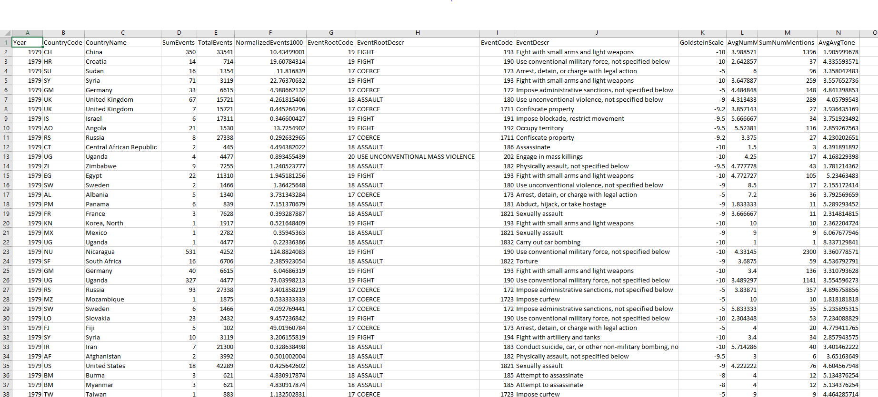
The Dataset
From Kaggle, built from the GDELT project’s database
14 columns and 176,432 rows
Variables include Year, Country, Type of Event, Number of Events
No empty rows

Slide 4
The Big Questions
1.
2.
3.
Has crime increased/ decreased in the past 4 decades? Is the trend different in different parts of the world?
Which area of the world was the most dangerous in 2020?
With time, which kind of crime activities show an uptrend or downtrend?
4.
5.
Which crime category is the most common in a given period of time? Does the ratio change with time?
Have mass shootings become more common in the U.S. in the past 20 years?

Slide 5
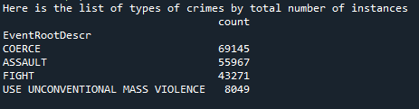
Increase in Crime over time

Slide 6


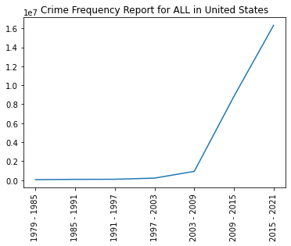
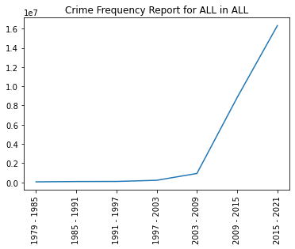
Increase in Crime over time

Slide 7
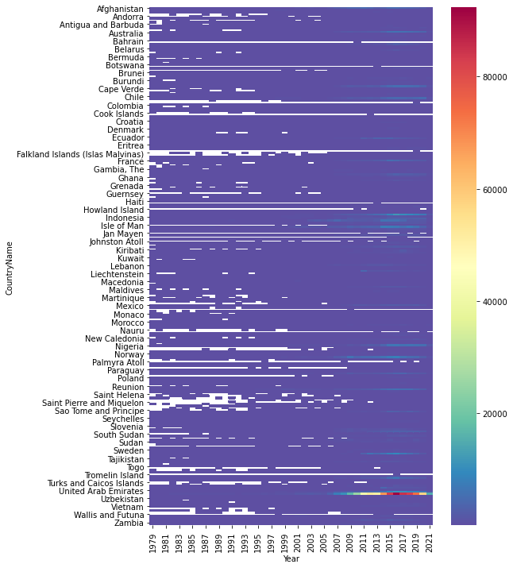
The total events change by year for countries

Slide 8
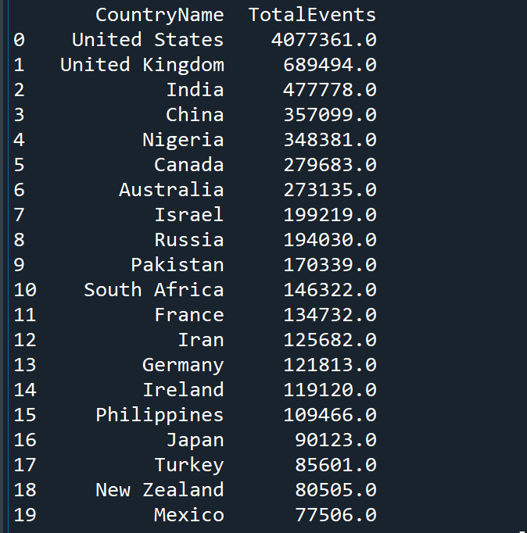
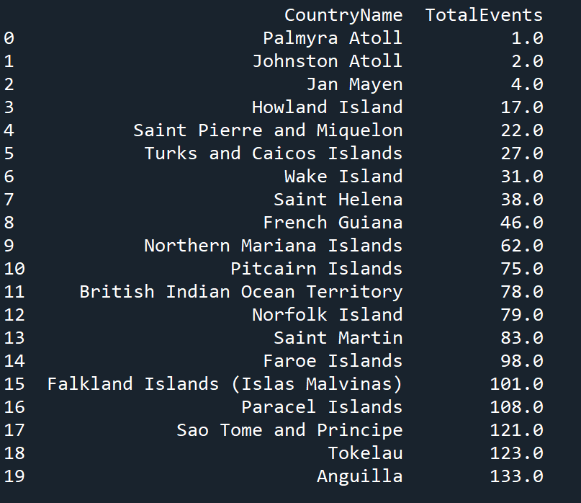
Total Crime Events by Country in 2021
Highest
Lowest

Slide 9
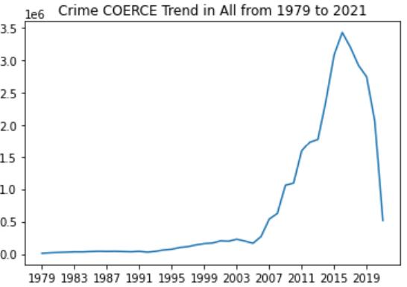
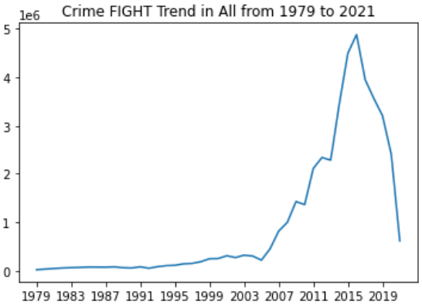
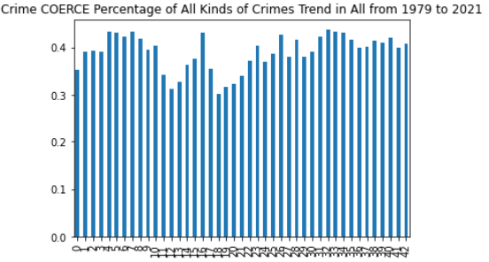
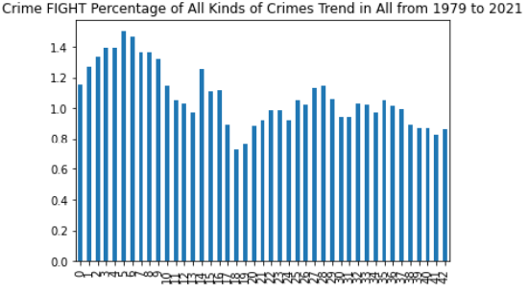
Trend of Crimes Globally or in Specific Countries
Coerce Globally Trend
Fight
Globally Trend
Coerce Ratio of
All Kinds of
Crimes Globally
Trend
Fight Ratio of
All Kinds of
Crimes Globally
Trend

Slide 10
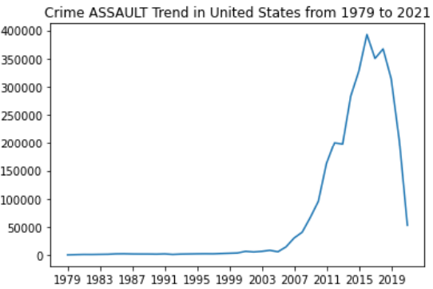
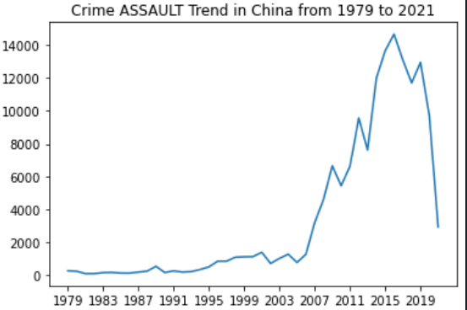
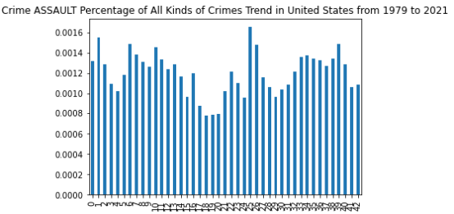
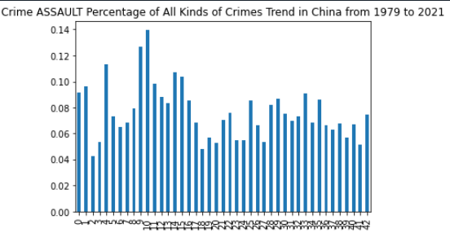
Trend of Crimes Globally or in Specific Countries
Assault
Of US Trend
Assault
Of China Trend
Assault Ratio
of All Kinds of
Crimes US
Trend
Assault Ratio of
All Kinds of
Crimes China
Trend

Slide 11
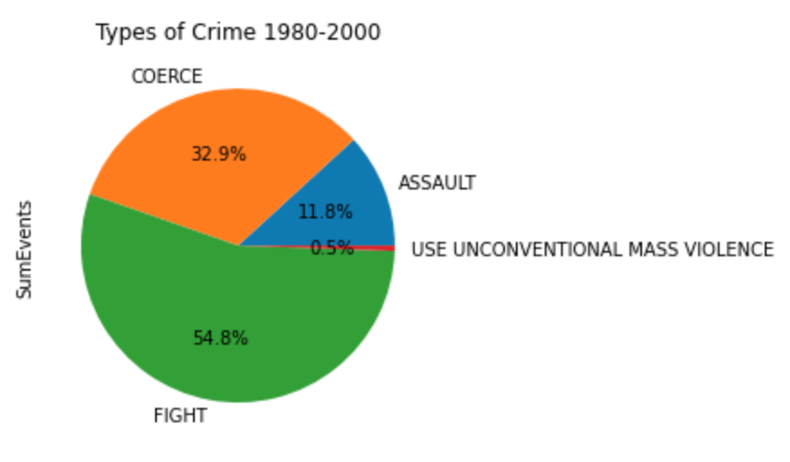
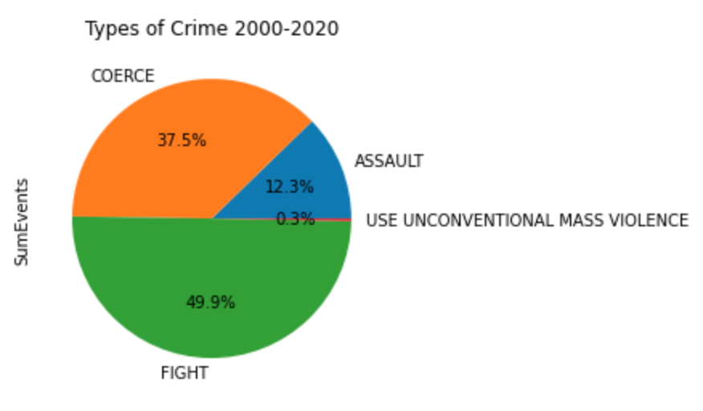
Change in Crime Types Over Time
From 1981-2000 to 2001-2020, the group of crime “Coerce” grew from 32.9% to 37.5% of total crime.

Slide 12
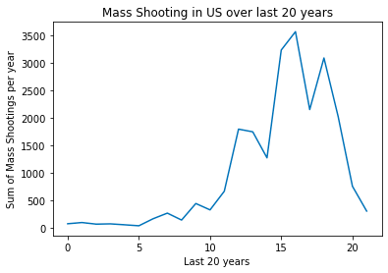
Increase in Mass Shooting in the US over the Last 20 Years

Slide 13
Thank you !

